Slide 1
Music Recommender System
with Million Song Dataset

Slide 2
Problem Statement
machine learning pipeline
combines content-based and collaborative recommendation system
goal
predict which songs that a user will listen to
make a recommendation list of 10 songs to each user

Slide 3
Datasets
Million Song Dataset (MSD)
meta-data, audio features, tags on the artist and song level, lyrics, cover songs, similar artists, and similar songs
280 GB
provides audio features
Taste Profile Subset
user ID, song ID, play counts
1,019,318 unique users

Slide 4
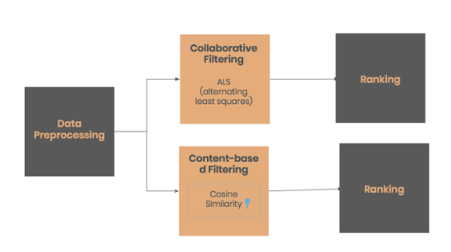
Methods
Collaborative Filtering
Content-Based Filtering

Slide 5
Collaborative Filtering
assumes similar users have similar music taste
the system only needs the previous vehaviors of users
Matrix Factorization
confront the problem of sparse data
ALS
decompose the user-item interaction maxtrix into the product of two lower dimensionality matrics
uncover the latent factors
minimize the least squares between predicted and actual ratings

Slide 6
Content-Based Filtering
base on the characteristics of an item in order to recommend items with similar properties
calculate cosine similarity between two different songs
pyspark.ml.linalg package

Slide 7
Metrics
Precision at k
how many of the first k recommended songs are in the of ground truth
Mean Average Percision (MAP)
how many of the recommended songs are in the set of ground truth
the order of the recommendations is taken into account
Normalized Discounted Cumulative Gain at k (NDCG)
how many of the first k recommended songs are in the set of ground truth averaged across all users
the order of the recommendations is taken into account

Slide 8
Results
generally low performance in terms of precision produced by the song recommendation system
Best performing model on Kaggle only achieved 0.17

Slide 9
Questions

